Slide 1

Beneficiary Consultation
Kumu Youth Academy
(Kumu Camp)
April 9, 2016
12:00 to 2:00 p.m.

Slide 2
Agenda
I. WELCOME
  Introductions
  Meeting Format
  Group Kuleana (Ground Rules)
II. WHY WE ARE HERE TODAY
  Conduct Beneficiary Consultation
  Provide current information about Kumu Camp
  Gather comments from Beneficiaries regarding long term license
IV. FACILITATED DISCUSSION
V. NEXT STEPS

Slide 3
Meeting Objectives
At the end of today, we will have:
An indication of support for long term license
Shared understanding of the Kumu Camp Project
List of the Project’s social, cultural & economic
benefits to the HHCA beneficiary community
Indication of the level of Beneficiary support for the programs and services provided by Kumu Camp
Notes:
3
Check for confirmation that these are the Meeting Outcomes for the day.
>>> Emphasize the FOCUS is on the PROJECT, not the organization AHHA/HCDC nor the people
Then state, after we achieve these Outcomes, the plan is to compile all the notes taken today, and department staff will prepare a report to the Commission, as part of the packet on issuing the Land Disposition for this Project
Shared understanding of the Project:
Description
Location
Programs/services the Project offers
How beneficiaries can get involved
How beneficiaries can use the Project – is there a fee? A reduced fee for beneficiaries? Vendor booth? Business incubation?
>>> Note: Hopefully, AHHA / HCDC will cover these points in the morning site visit
These latter 2 outcomes we will handle in breakout groups, depending on size of audience

Slide 4
HHC Beneficiary Consultation
Policy of Consulting Beneficiaries for:
  Land Use Projects, Long-Term Leases/Licenses
Consultation Meeting
  What’s Being Proposed?
  Do the Beneficiaries Support the Project?
  Will the Project Provide Benefits for Beneficiaries?
  Record Beneficiary Input
One-Month Consultation Period
  Receive Written Comments (email or mail)
Consultation Report to HHC
  Who Came to the Meeting
  Summarize Main Points and Attach Full Record of Comments
Notes:
4
Check for confirmation that these are the Meeting Outcomes for the day.
>>> Emphasize the FOCUS is on the PROJECT, not the organization AHHA/HCDC nor the people
Then state, after we achieve these Outcomes, the plan is to compile all the notes taken today, and department staff will prepare a report to the Commission, as part of the packet on issuing the Land Disposition for this Project
Shared understanding of the Project:
Description
Location
Programs/services the Project offers
How beneficiaries can get involved
How beneficiaries can use the Project – is there a fee? A reduced fee for beneficiaries? Vendor booth? Business incubation?
>>> Note: Hopefully, AHHA / HCDC will cover these points in the morning site visit
These latter 2 outcomes we will handle in breakout groups, depending on size of audience

Slide 5
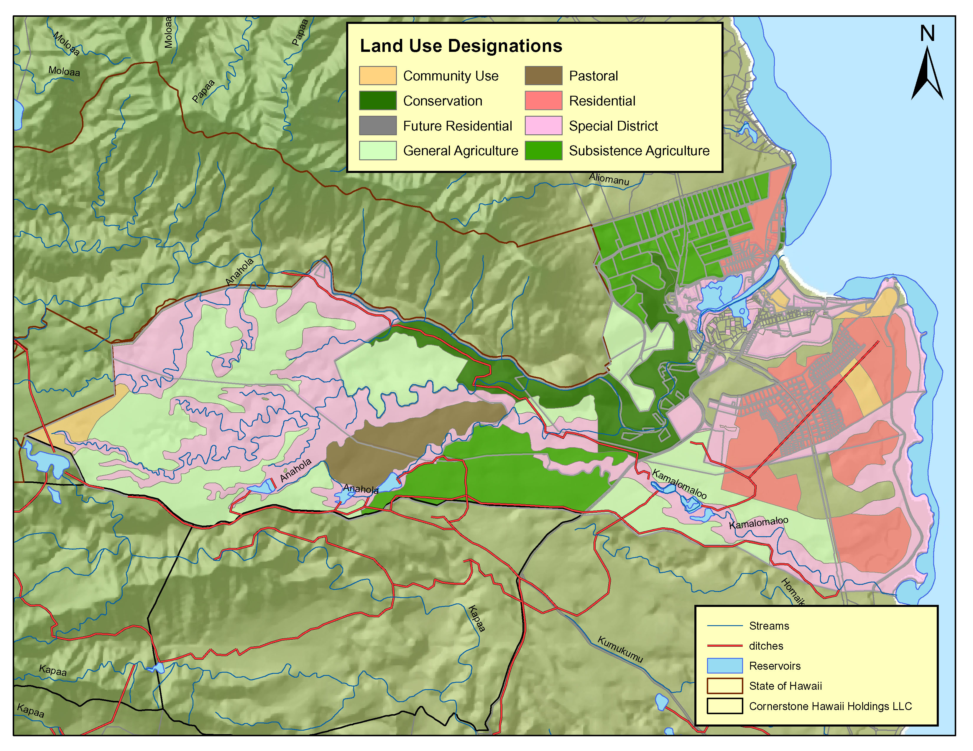
DHHL Anahola Lands
  Approximately 4,500 acres
  (21% of Kaua‘i lands)
  267 Subsistence Agriculture
Anahola Homesteads
  535 Residential & 46 Agriculture Lessees
  On Deck: Pi‘ilani Mai Ke Kai

Slide 6
Planning Activities
TIMEFRAME | ACTION
2004 | Kaua‘i Island Plan-designates (zones) site as “Special District” and “Community Use”
2010 | Anahola Regional Plan identifies a “potential project” for a “Kumu Academy” retreat for Hawaiian organizations, cultural practitioners, kumu and homesteaders around the base of Anahola River.
2011 | -- DHHL issues AHHa/HCDC a Month-to-Month Revocable Permit for the Site -- AHHA/HCDC Cleans Area, Installs Tentalos and Portable Lua, etc. -- AHHA/HCDC Starts to Host Youth Groups
2012 | -- AHHA/HCDC Submits Land Use Request for the Site -- AHHA/HCDC Publicize that Kumu Camp is Open for Business
2013-2015 | -- AHHA/HCDC Secure Grants for Improvements -- Hires a Planning Firm to Prepare an Environmental Assessment (EA)
Oct. 2015 | HHC Workshop on Draft EA—HHC requests additional due diligence
Dec. 2015 | Staff Conducts Site Visit and Holds Meetings with State and County agencies
Jan. 2016 | HHC Issues a Finding of No Significant Impact for the EA
Notes:
6
Check for confirmation that these are the Meeting Outcomes for the day.
>>> Emphasize the FOCUS is on the PROJECT, not the organization AHHA/HCDC nor the people
Then state, after we achieve these Outcomes, the plan is to compile all the notes taken today, and department staff will prepare a report to the Commission, as part of the packet on issuing the Land Disposition for this Project
Shared understanding of the Project:
Description
Location
Programs/services the Project offers
How beneficiaries can get involved
How beneficiaries can use the Project – is there a fee? A reduced fee for beneficiaries? Vendor booth? Business incubation?
>>> Note: Hopefully, AHHA / HCDC will cover these points in the morning site visit
These latter 2 outcomes we will handle in breakout groups, depending on size of audience

Slide 7
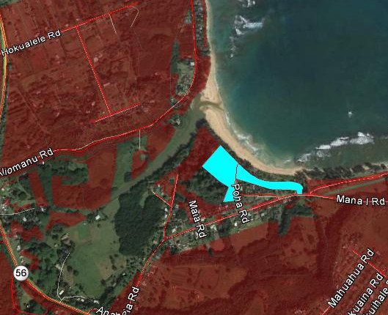
Site Information
KUMU CAMP
5 acres of 8-acre Parcel
Notes:
7
Check for confirmation that these are the Meeting Outcomes for the day.
>>> Emphasize the FOCUS is on the PROJECT, not the organization AHHA/HCDC nor the people
Then state, after we achieve these Outcomes, the plan is to compile all the notes taken today, and department staff will prepare a report to the Commission, as part of the packet on issuing the Land Disposition for this Project
Shared understanding of the Project:
Description
Location
Programs/services the Project offers
How beneficiaries can get involved
How beneficiaries can use the Project – is there a fee? A reduced fee for beneficiaries? Vendor booth? Business incubation?
>>> Note: Hopefully, AHHA / HCDC will cover these points in the morning site visit
These latter 2 outcomes we will handle in breakout groups, depending on size of audience

Slide 8
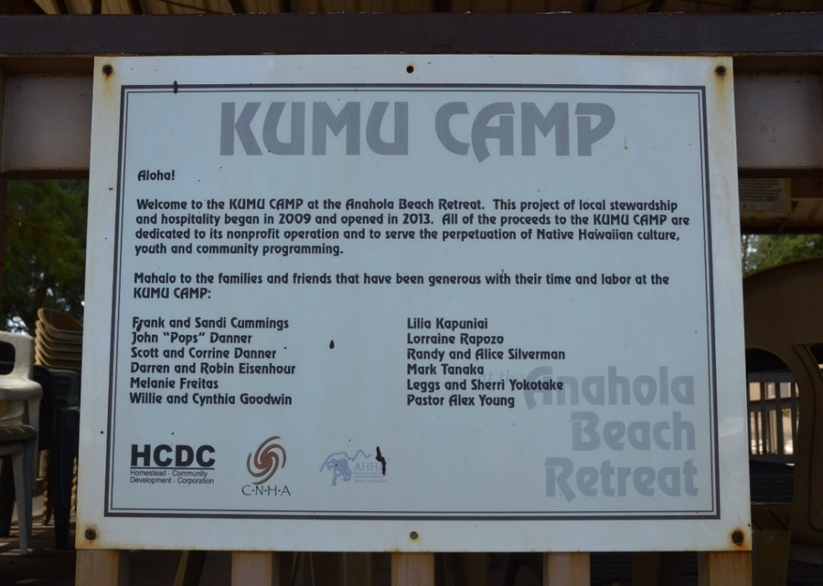
History of Kumu Camp
History of drug use and need to develop a project for a youth and kupuna to serve the needs of Anahola Homestead Community.

Slide 9
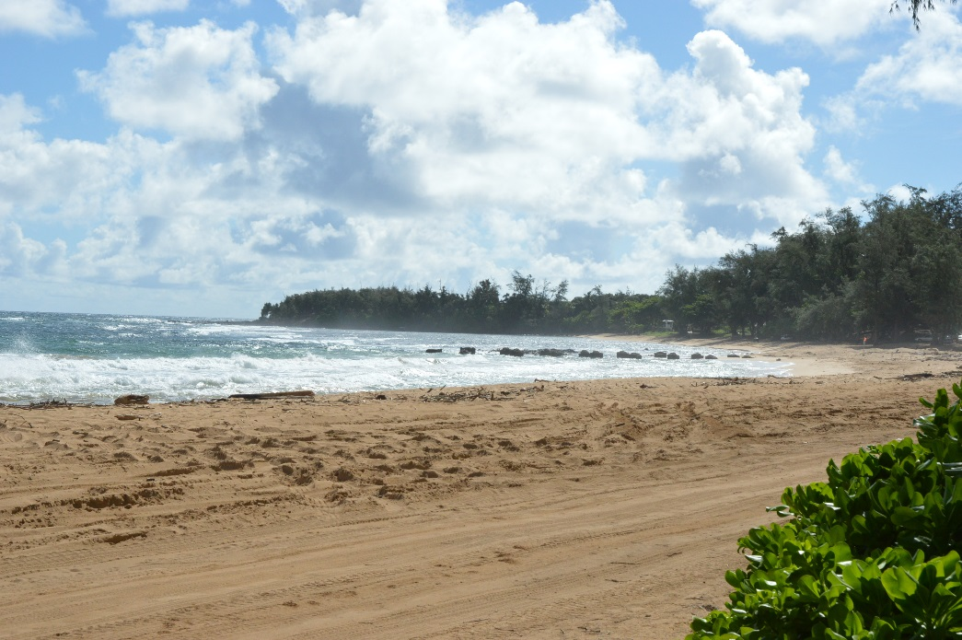
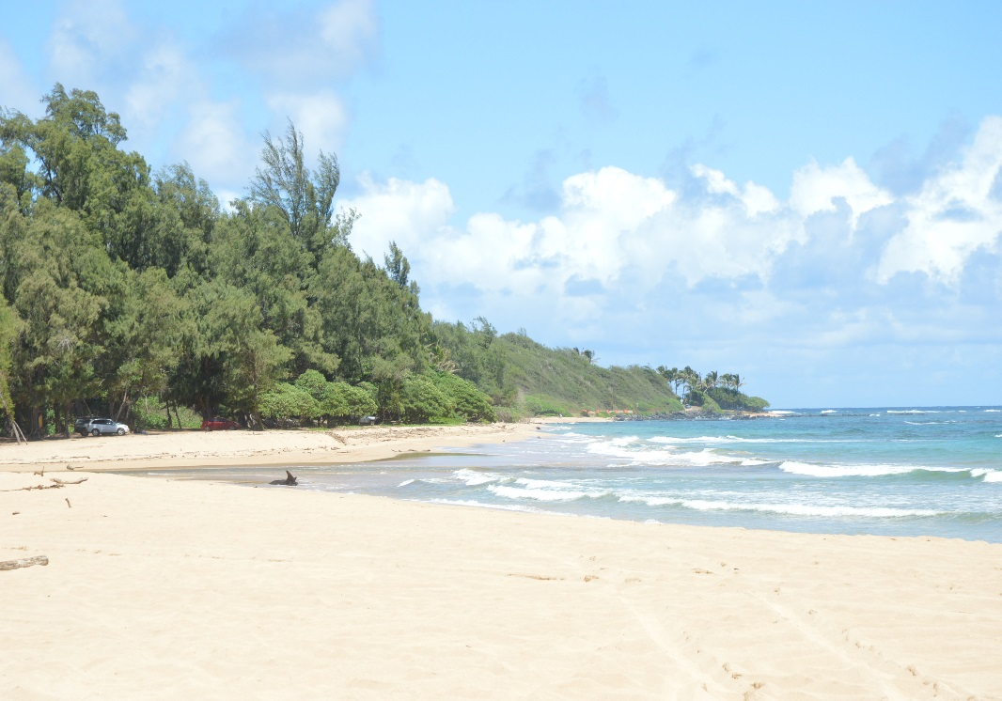
Kumu Camp Activites
Educate youth about cultural resources, practices and history of Anahola Bay
Provide Youth activity and other sports programs

Slide 10
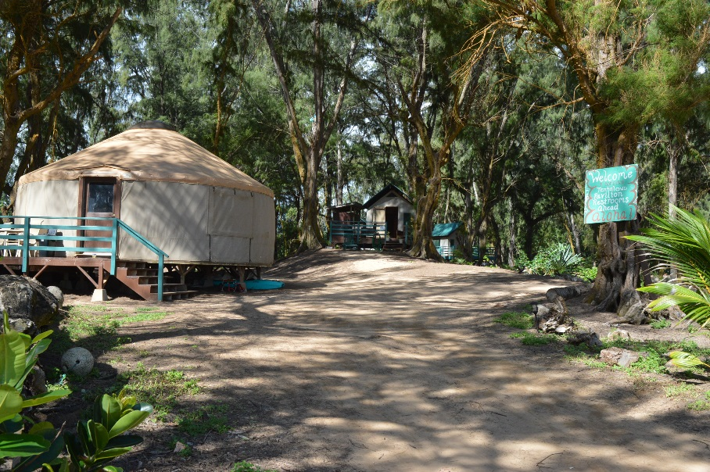
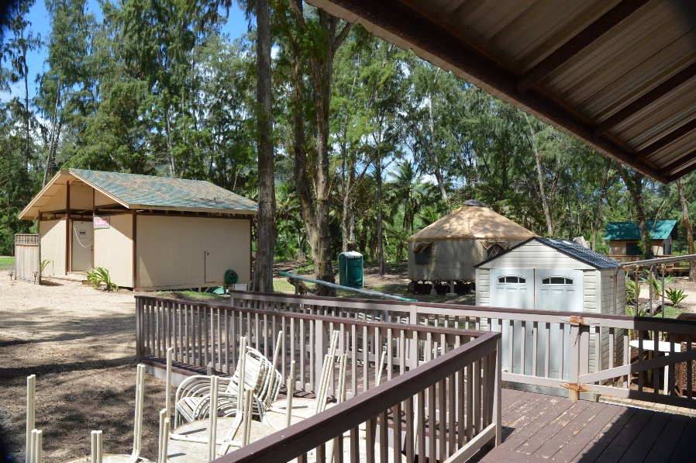
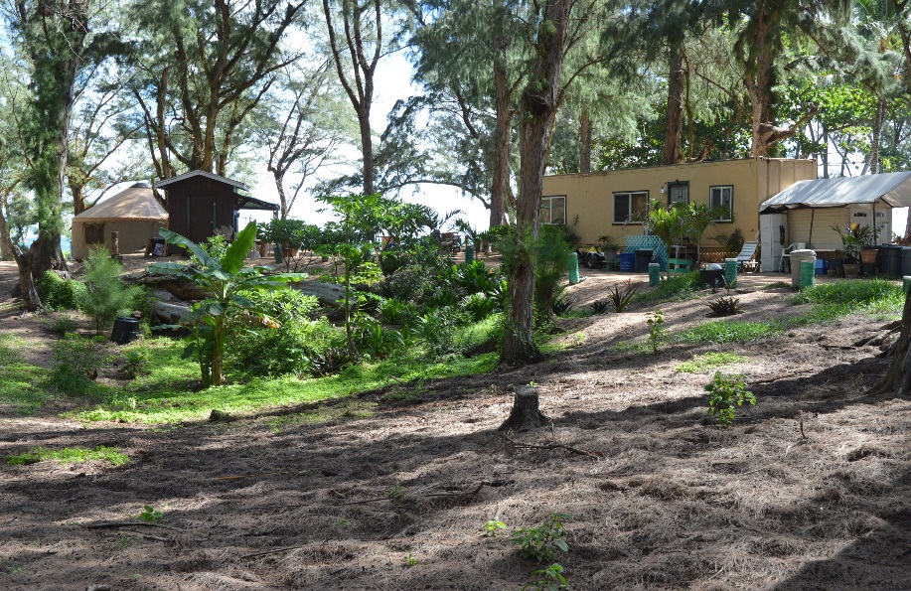
Kumu Camp Facilities
Facilities are available for youth camping activities, capacity to provide group and individual camping, maintenance and management operations

Slide 11
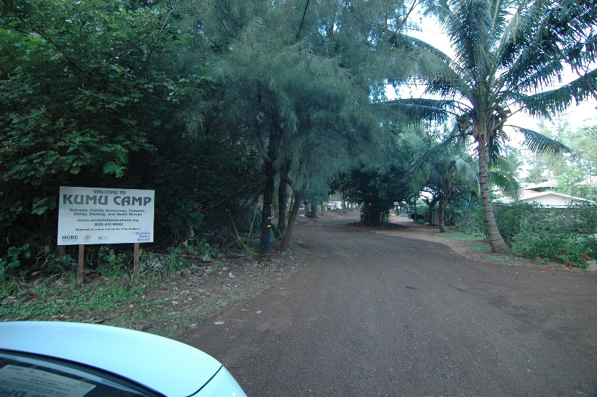
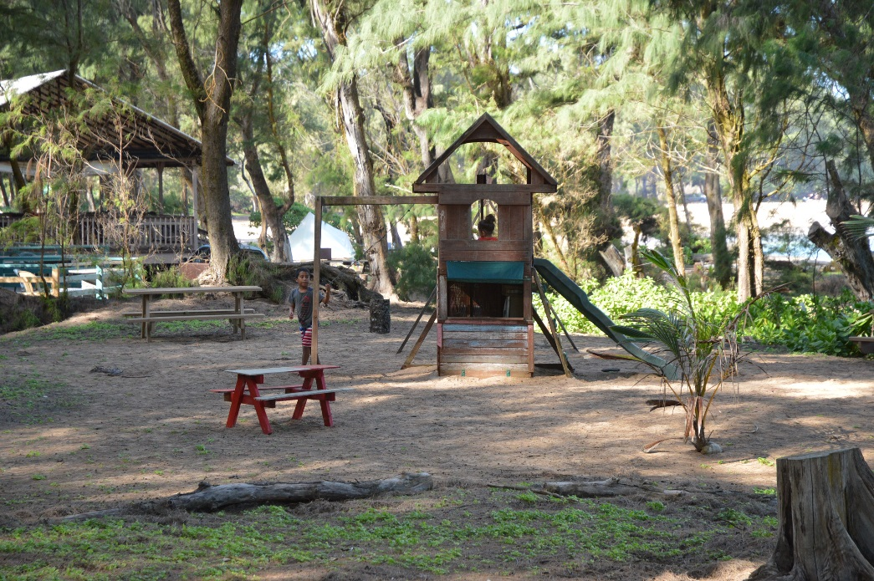
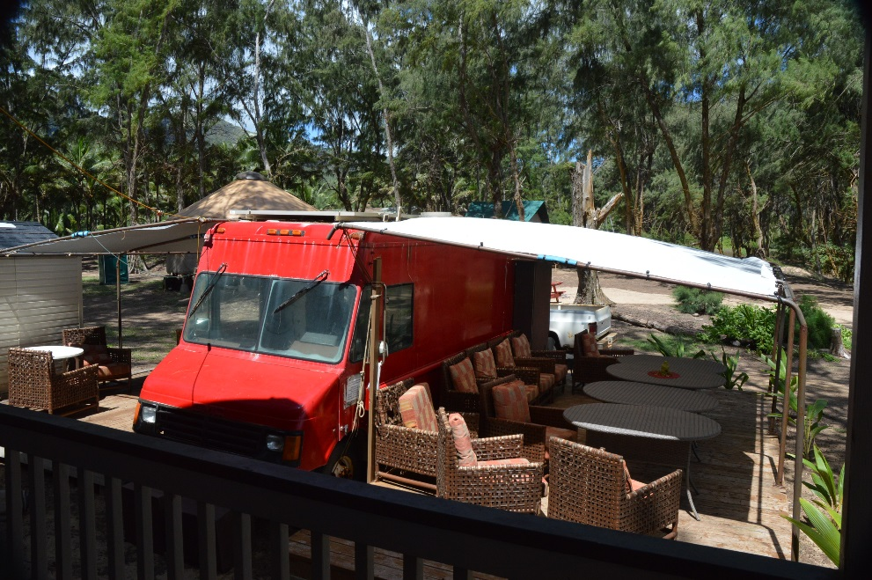
Kumu Camp Uses
Homesteaders and homestead organizations can use the facilities, there is a fee for use (homesteaders and non homesteaders use fees vary) see fee schedule for reservation requirements

Slide 12
Long Term License Requirements
DOH Approval for Waste Water System
Incorporation of recommendations from Beneficiary Consultation
Authorized uses and mitigation measures described in the Environmental Assessment and approved by the HHC and other HHC terms and conditions if applicable will be incorporated into the license

Slide 13
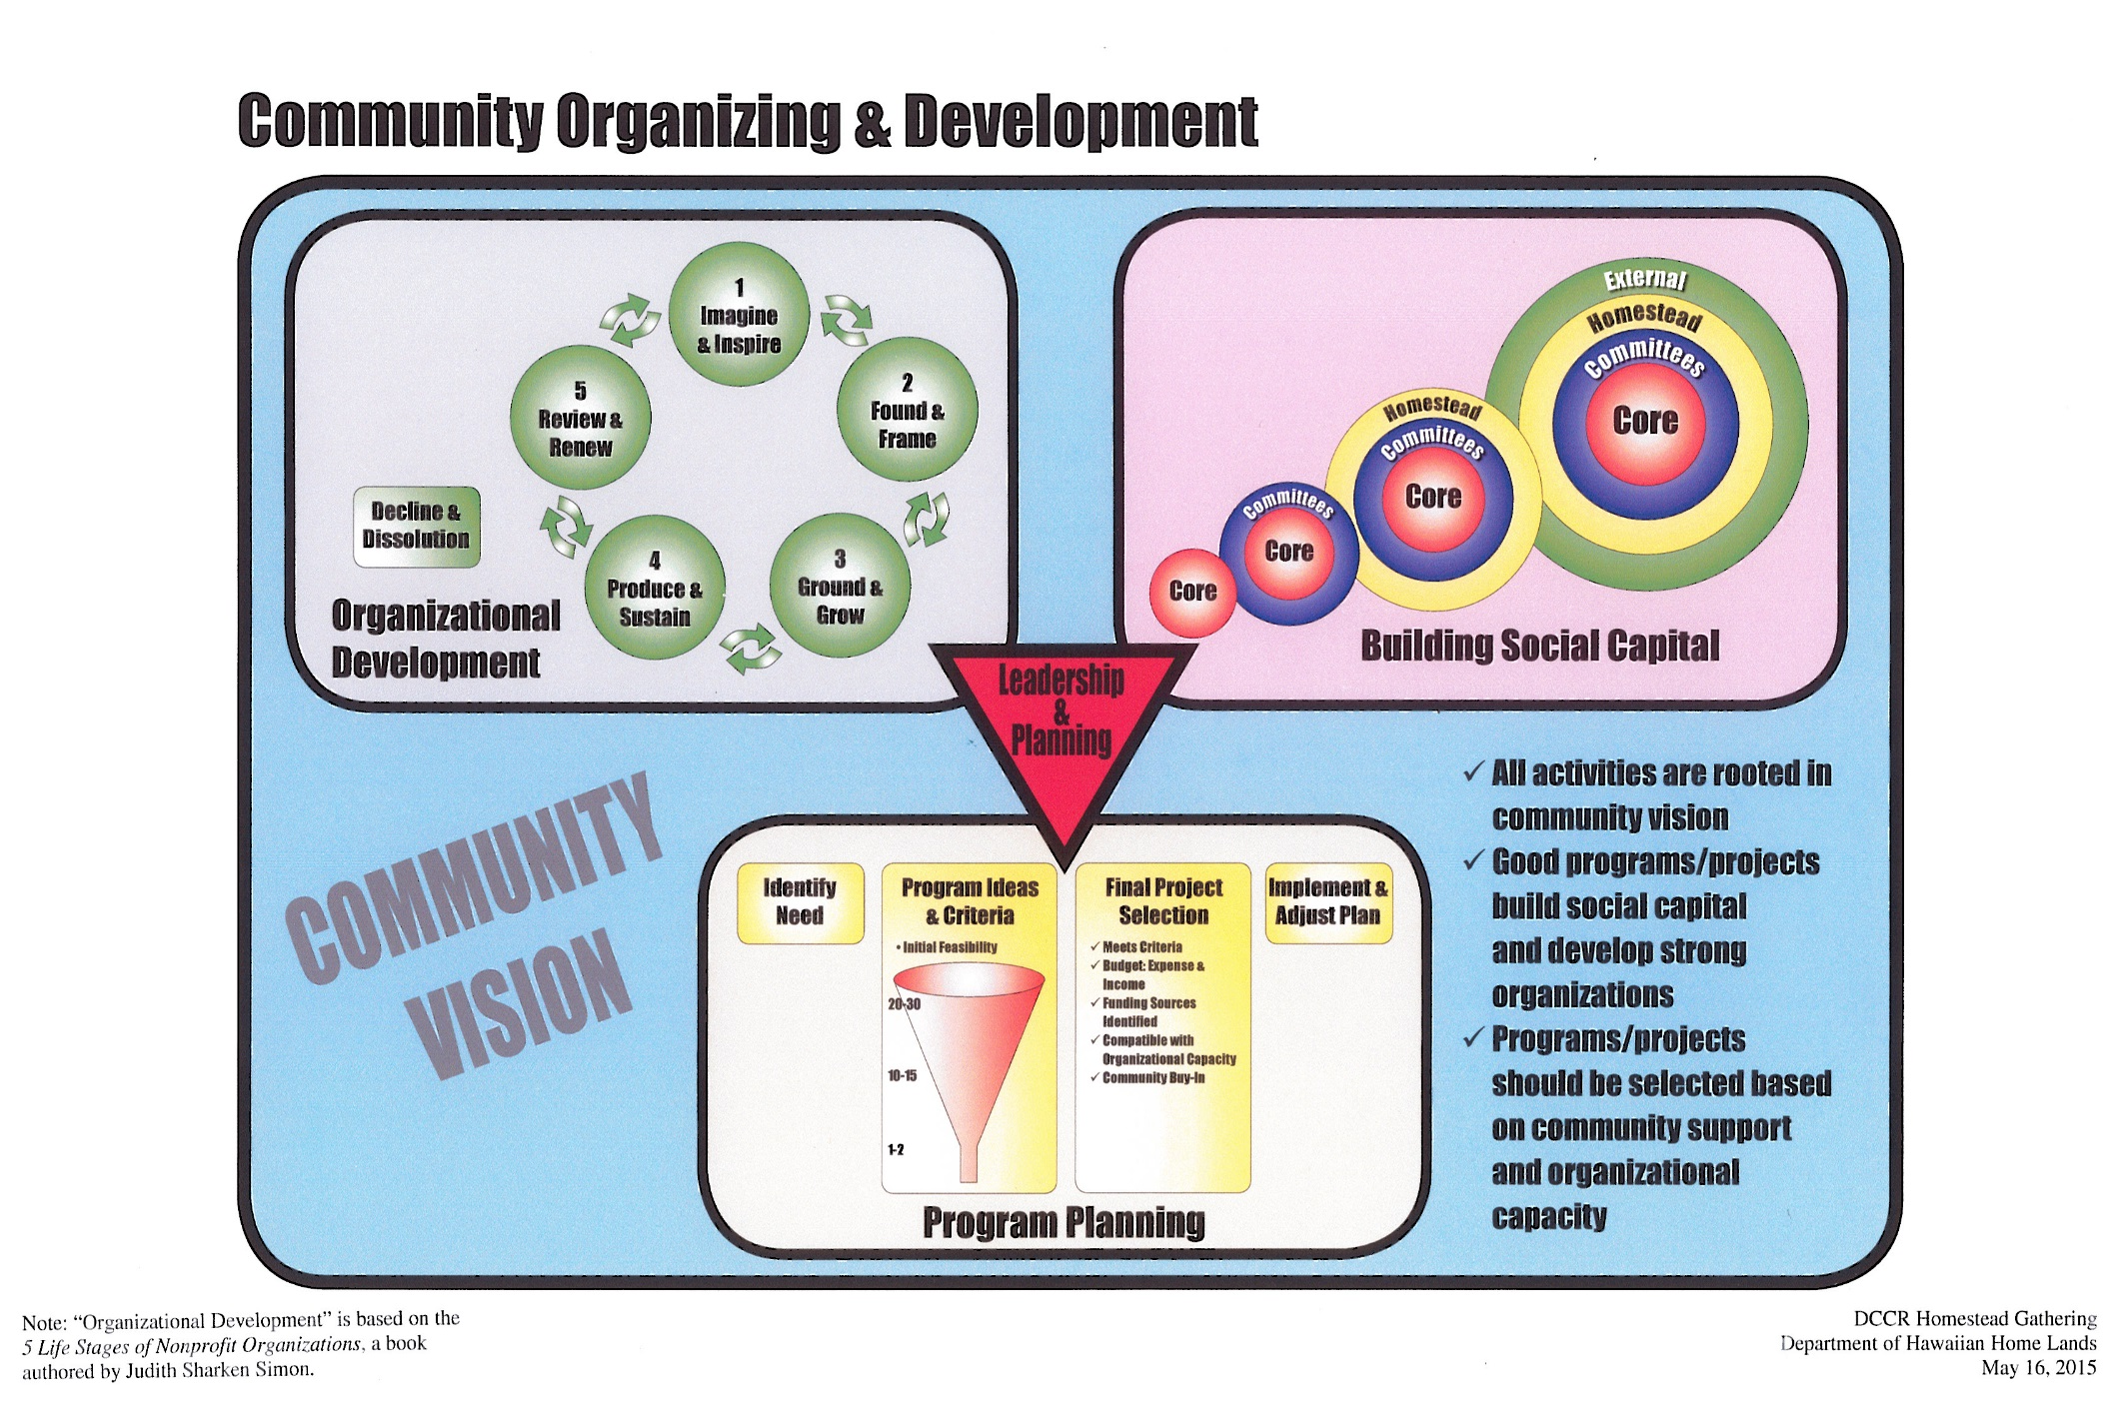
Notes:
The department has recently organized its due diligence process for all land dispositions moving forward.
As the department reviews requests for land, organizations requesting land are asked to provide information in these 3 areas: Organizational capacity; Project Business Plan; and community support or what is the extent of social capital that’s been built in support of this project. Department staff then review the information provided, before a Submittal can move forward to the Commission.
Where we are today with the Kumu Camp Project is here – Social Capital. [ Move on to Soc Cap slides, if Overview of Flow Chart not needed ]
We are NOT discussing Org capacity nor Project Business Plan, today.
If these are addtl areas you would like to discuss, then we’ll need to schedule another meeting at another time.
[ Do Overview of Flow Chart, if needed ]
This is a dynamic Flow Chart created by DHHL. It shows 3 basic ingredients to Community Organizing & Development.
First and foremost is COMMUNITY VISION. Everything you do must be based on that common shared Vision.
This is where you do needs assessments, surveys, check Census Data, DHHL Plans – Island Plan, Regional Plan, NHDPP
This is where you are actively engaged with community to identify opportunities, problems, conditions, situations that you want to address
This is also where you identify assets & resources within your community. Some times called Asset or Resource Mapping – meaning who are the individual people, skills/talents “in your backyard” . . . orgs within the homestead or potential partners, institutions, stakeholders, funders, etc.
SOCIAL CAPITAL
Determine your social capital.
Who’s your Core?
Do you have Committees to help do the work?
How engaged are you with the beneficiaries in this geographic area / your service area / this island?
What connections & relationships do you have with current homestead associations, other beneficiary orgs, DHHL, External Stakeholders, Funders, other nonprofits / orgs that would be willing to help you achieve your goals?
ORGANIZATIONAL DEVELOPMENT
You need strong organizations to organize the community and get projects done. This diagram & model comes from a book called “5 Life Stages of Nonprofit Organizations” authored by Judith Sharken Simon. This is just one of many other Nonprofit Org models out there. This is a widely used model in the nonprofit sector. I like this one – (1) the book is an easy read and good explanations; (2) comes with a free self-assessment in the book as well as on-line
Simon and her team observed 100’s of nonprofits and found that Nonprofits have a Life Cycle. They are born by an idea, a group of concerned citizens that want to address a problem/situation. That’s stage 1 Imagine & Inspire ( 0 – 5 years)
Stage 2 (1 – 2 years) – the “concerned citizens” then decide to form a Formal Organization – Sometimes it’s community driven. Sometimes an association is formed for you, by the developer (DHHL, Dowling, etc). For DCCR homesteads, purpose was given to you – to manage & enforce the DCCRs. Lastly, sometimes a nonprofit is formed by an entity external to the community – such as a Foundation that needs a nonprofit to administer its funds; Waiakea shopping center/WalMart Hilo formed Haola Inc. to administer funds
Stage 3 is Ground & Grow. (2 – 5 years)
Stage 4 (7 – 30+ years) is generally a mature , well established nonprofit. Has grown to have paid staff and steady stream of revenue. Has a good reputation in the community for delivering high quality services/programs. Funders also know this nonprofit well. Has a high level of Social Capital.
Finally, there’s State 5 – Review & Re-new. What would cause a nonprofit to “pause”, reflect on itself, re-invent itself?
There is one more Stage , which is Decline & Dissolve. It doesn’t have a number in the Life Cycle, because it can happen at any Stage.
The third ingredient is Program Planning.
Whatever your Program is . . . . Again, must be based on Community Vision
Generally, you Identify a Need, Opportunity or Problem or condition/situation in the community that you want to address
You come up with Criteria and brainstorm lots of ideas, maybe 20 – 30 ideas. Run them through the criteria and whittle down the list of ideas.
Then , you end up with 1 – 2 ideas
Approve your Final Project Selection
It met the criteria
You figured out the Budget – Expenses (pre-dev costs, dev/construction, operating/maintenance, reserve fund) & Income (where $$$ come from – user fees, subsidy, grants, loans)
Is this Project compatible with your Org’s Capacity? Is there another Org to partner with to help carry out / implement the Project?
Does the project have Community buy-in; Have BROAD community support; and CONNECTIONS with others, larger community, stakeholders, funders, etc.
Come up w/ Program Plan, implement & adjust your Plan as you go , even if it means “no go “ decision later on
>>>>> With Good Leadership and Planning, you will have strong organizations, you would have built social capital, and you will have good programs & projects that are sustainable and financially viable. <<<<<<<<

Slide 14
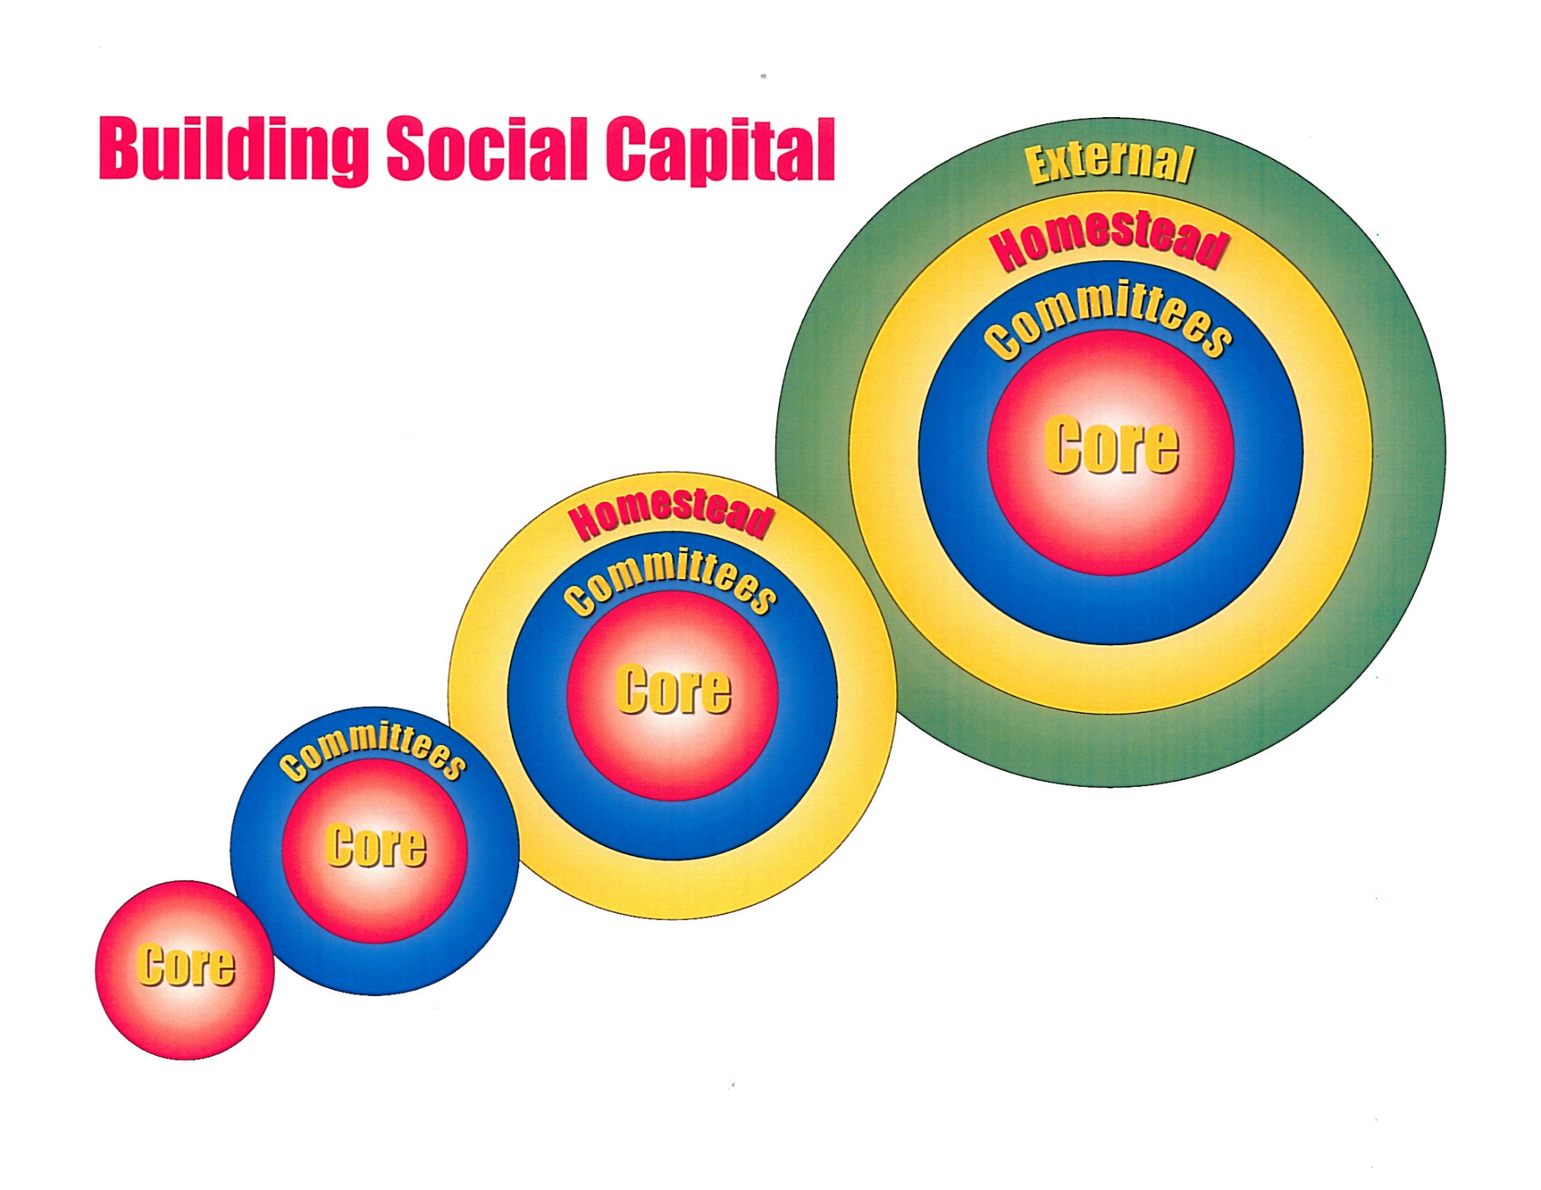
Notes:
This is the component of the Comm Dev Flow Chart that we are focusing on today ---- Building Social Capital
We are tasked by Commission to assess the level of “community support” . . . . Our job as DHHL is to report back to the Commission on “YES” there is overwhelming community support for this Project . . . . or “NO” there is not enough community support
Secondly, the department also wants to ask you, the beneficiaries, what do you see as the social, cultural, and economic benefits or impact of this Project Kumu Camp?

Slide 15
Consultation Discussion
Breakout in groups organized by:
  HHCA Beneficiaries: Applicants, Lessees, Successors
  Non-HHCA Beneficiaries
Notes:
15
Depending on audience size, mood of group & stakeholders, etc.
If manageable, we could break out simply in to 2 groups: Beneficiaries & Non
Under this scenario, DHHL staff are:
Group 1 Beneficiaries: Gigi (facilitator), Julie (recorder), Kaipo (back up)
Group 2 Non-Beneficiaries: Bob (facilitator), Nancy (recorder), Mona (back up)
If we need to break out in to more than 2 groups . . . .
We could do 2 Beneficiary groups and 2 Non
Under this scenario, my suggestion is:
Group 1: Gigi
Group 2: Julie & Kaipo
Group 3: Bob & Ulu
Group 4: Nancy & Mona

Slide 16
Discussion Questions
What do you see are the social, cultural & economic benefits to you and your community?
On a Scale of 1 to 5, how strongly do you support this Kumu Camp project?
Notes:
16
Check for confirmation that these are the Meeting Outcomes for the day.
>>> Emphasize the FOCUS is on the PROJECT, not the organization AHHA/HCDC nor the people
Then state, after we achieve these Outcomes, the plan is to compile all the notes taken today, and department staff will prepare a report to the Commission, as part of the packet on issuing the Land Disposition for this Project
Shared understanding of the Project:
Description
Location
Programs/services the Project offers
How beneficiaries can get involved
How beneficiaries can use the Project – is there a fee? A reduced fee for beneficiaries? Vendor booth? Business incubation?
>>> Note: Hopefully, AHHA / HCDC will cover these points in the morning site visit
These latter 2 outcomes we will handle in breakout groups, depending on size of audience

Slide 17
Next Steps
30-day comment period – comments due by May 9, 2016
Prepare Beneficiary Consultation report June to July 2016
Hawaiian Homes Commission Meeting to be determined
Mail Comments to: Email comments to:
Department of Hawaiian Home Lands DHHL Planning Office
Attn: Planning Office DHHL.Planning@hawaii.gov
P.O. Box 1879
Honolulu, Hawaii 96805
Notes:
I took a stab at a slide for “Next Steps” . . . . This is only a suggestion.
You’re welcome to use this, change it, delete it, etc

